Slide 1


Data Analysis
Notes:
Hello and welcome, my name is Shivamalu Poojari and today I will be presenting to you the results of the Data Analytics task.

Slide 2


Today's agenda
Project recap
Problem
The Analytics team
Process
Insights
Summary
Notes:
Today's agenda will be as follows:
1. We will recap the overall project to give a high level understanding of the business problem we're tackling and the specific requirements.
2. We will dive into the specific problem that we, the Data Analytics team, have been focusing on and will give some background as to why this is such a big problem.
3. After introducing the problem, I will go over the team responsible from our side in tackling this task.
4. I will then go over the high-level process that we followed to complete this task, so that you have complete clarity in how we tackle these kinds of tasks.
5. Finally, I will go over the all important results and I will present them as a series of insights and visualizations from our analysis.
To wrap up, I will summarize and open for any questions.

Slide 3
Social Buzz is a fast growing technology unicorn
that need to adapt quickly to it’s global scale.
Accenture has begun a three month POC focusing
on these tasks;
An adult of Social Buzz’s big data practice
Recommendations for a successful IPO
Analysis to find Social Buzz’s top 5 most Popular
categories of content
Project Recap
Notes:
To kick things off let me recap this engagement.
We, Accenture have embarked on a 3 month pilot with Social Buzz to focus on 3 main tasks, aligned with some of the biggest challenges that you're currently facing.
Social Buzz has reached huge scale in recent years to become recognized as a global unicorn company. We are here to help you manage this scale and to guide you in the right direction.
Firstly, we will be doing an audit of your big data practice and sharing best practices and industry expertise. Secondly we will be guiding you through a successful IPO, of which we have deep expertise and knowledge of within our team. And finally, we have conducted an analysis of your data to find insights regarding your top 5 most popular categories of content

Slide 4

Problem
Over 100000 posts per day
36,500,000 posts every year!
But how to capitalize on it when there is so much?
Analysis to find Social Buzz’s top 5 most popular categories of content
Notes:
Focusing on the last point that I mentioned there, this is what the Data Analytics team has been specifically focused on.
Clearly with such grand scale, this comes with a lot of data and with such vast amounts of data comes challenges.
To give a background on how much data you've been creating:
- You told us that your platform receives over 100000 posts per day which amounts to 36 500 000 posts every year, of which, this is all unstructured data making it very hard to make sense of.
In this day and age, content is king. Just look at some of the biggest platforms in the world, for example YouTube, Facebook and Netflix... they are all content businesses...
But how to capitalize on it when there is so much?
It's not just all about harvesting as much content as possible... The real value is in understanding and crunching this content to gain a deeper understanding of your audience and to therefore provide a more personalized and enjoyable experience.
And this is where out data analytics expertise comes in, with the insights that we've uncovered from this task, we can show you exactly how to take analytics to production at scale.

Slide 5



MELISSA MARTINEZ
Senior Analyst
Architect
The Analytics team
KIAN FARAHBAKHSHIAN
Business Analyst
integration Architect
SHIVAMALU POOJARI
Data analyst
Notes:
Talking about experience, we have a large data analytics practice at Accenture but we had a team of 3 people primarily focusing on this task. Melissa Martinez, is our software Architect and her expertise really helped to guide the team to produce high quality analysis.
Kian Farahbakhshian, a Business and integration Architect senior Analyst expert has worked with the worlds biggest clients on solving their data problems and was heavily involved in the data engineering side of this project.
And finally myself, [NAME], who was solely responsible for taking leadership guidance and delivering high quality insights from the raw datasets and turning these into business decisions.

Slide 6

Process
1
Data understanding
2
Data cleaning
3
Data Modeling
4
Data Analysis
5
Uncover Insights
Notes:
So, how did we tackle this problem?
Well, we approached it in 5 steps:
1. Data understanding - the key to success on any data project is to understand the data in detail. So we took the time to understand the data model and domain of your business.
2. Data extraction - after understanding your business, we then architected what an ideal dataset should look like for this problem and extracted it from the relevant data sources.
3. After extracting the raw data, we needed to process and model this data into a dataset that can precisely answer the business questions and produce analytics.
4. With our new dataset, we used our analytical expertise to uncover insights from this dataset and to produce visualizations to describe the insights.
5. And finally we used these insights to unlock business decisions and to make recommendations on next steps.

Slide 7

Insights
16
UNIQUE
CATEGORIES
1897
REACTIONS TO ‘ANIMAL’
POSTS
MAY
MONTH WITH
MOST POST
Notes:
From your data we found that you had a total of 16 unique categories of posts across your sample dataset. This includes things such as Food, Culture and Sport.
As well as this, there was 1913 posts from just the Food category alone! People obviously really like food!
And also the most common month for users to post within was December, since this is such a seasonal month with so many holidays and events, this is interesting to know that people are most active during this month!
But now, onto the main question... which is... what were the top 5 most popular categories of posts?

Slide 8
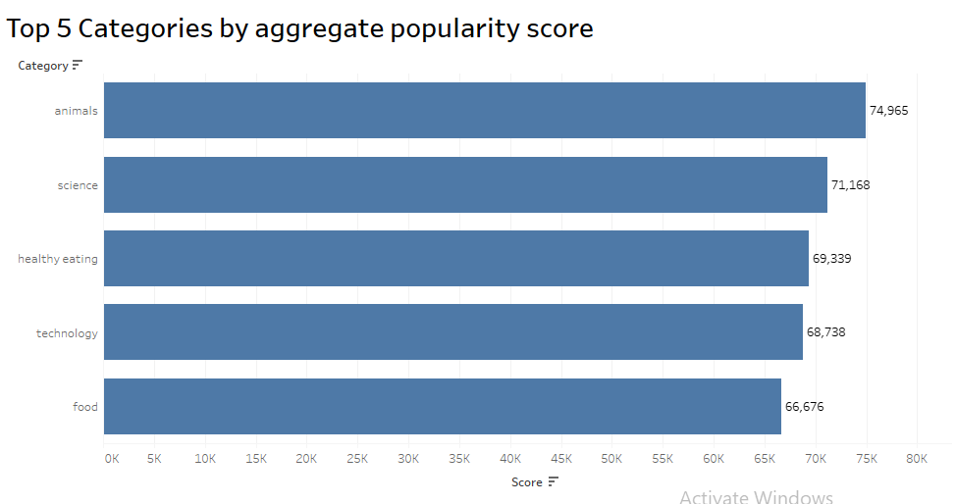
Notes:
From our analysis you can see that the top 5 most popular categories of posts were Animal, science, Healthy eating, technology and Food in descending order.
Animal had an aggregate popularity score of almost 75000. It is very interesting to see both food and healthy eating within the top 5, it really shows what people enjoy consuming as content. Healthy eating ranks higher than food. This shows people are more health conscious.
Finally, it’s also interesting to see science and technology too. This may suggest that people enjoy consuming factual content that they can learn somethingfrom.

Slide 9
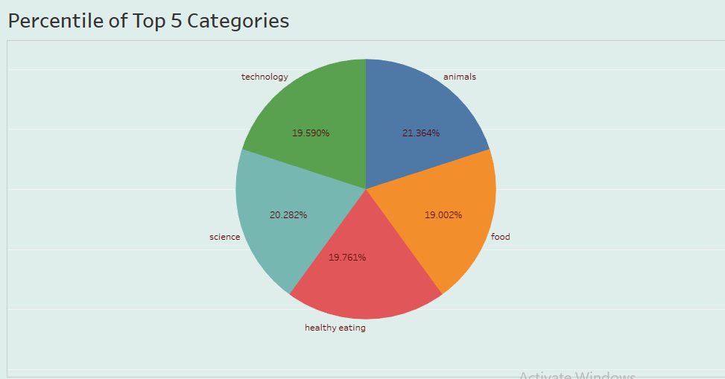
Notes:
Additionally, you can see from this chart the % split of popularity between the top 5 categories. There is not much difference between each of them, animals only outperforms science by 0.9% within the top 5.
However the difference between the 4th most popular, Technology, and the 5tgh most popular, Food, is larger at 0.6%
This tells me that the categories sorted by popularity is weighted towards categories at the top. This means that it exhibits a "greedy" effect, the most popular categories get more popular whilst as you drop down the popularity rankings, you may see that they fall away drastically.

Slide 10
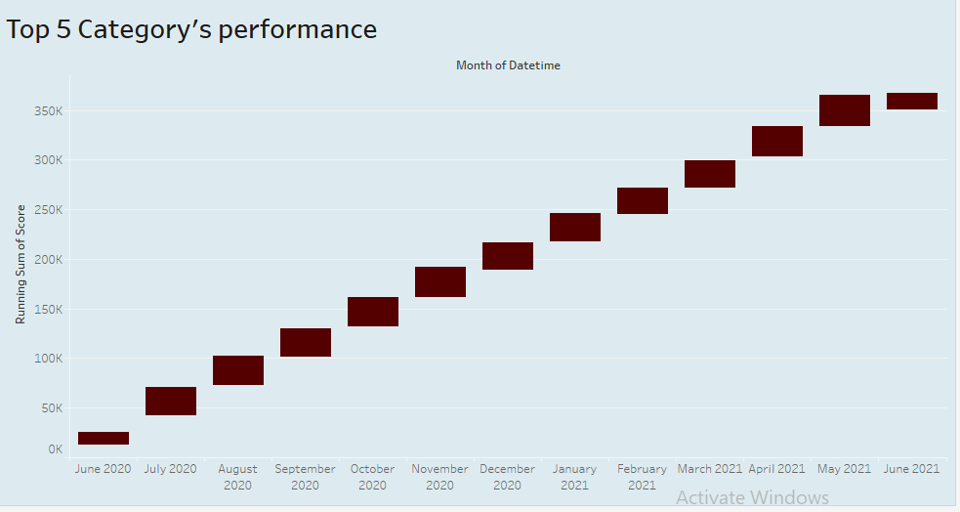
Notes:
This chart shows us that the score of top 5 categories together scores very low in the month of June 2020 and the same month of 2021 scores very low.
April and May these two months weighted scores almost 31,000 individually. The very next month of year 2021 that is June scores very marginal less in the last six months that is 16,700
However, the difference between the last two months scores that is May 2021 and June 2021 is 14,100

Slide 11
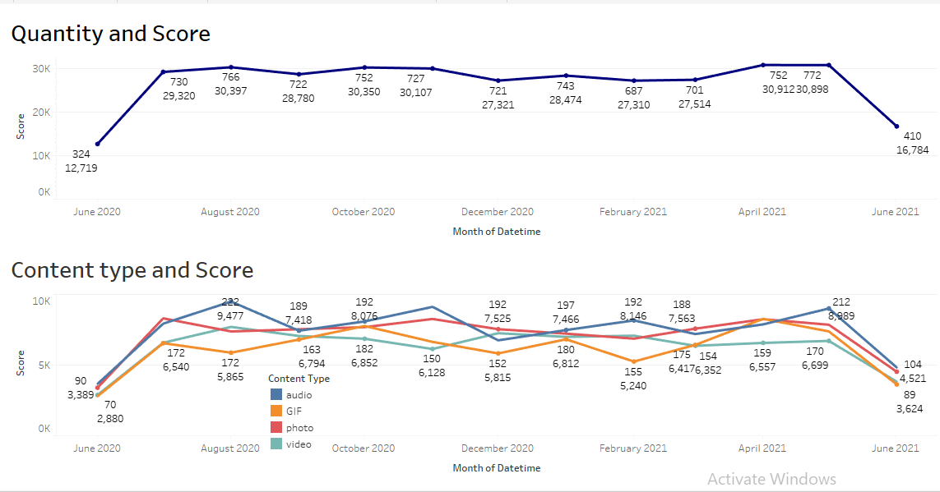
Notes:
Addition to that, we can see the variation in the score of top 5 categories together falling down in the month June 2021. you can see the reason here that the quantity of content is also varying.
And alone audio of top 5 categories brought the nearly 9500 score from 222 posts in a month.
This chart tells us that, the number of post are directly proportional to the scores. Upload more and more contents and it will results in getting more positive reactions.

Slide 12
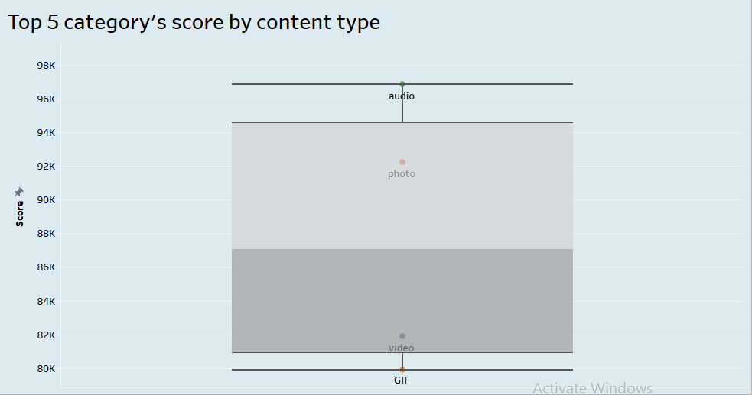
Notes:
Addition to that, in this chart audios are the most popular content type with 97000 score points, and GIF becomes the least popular content type with 80000 score points.
The average popularity score of content type is 87,000. and photos popularity is above average and video has 6000 points short to become a popular content type.
“This chart tells me that in order to get more and more positive reactions from people is by uploading more number of audio and photos than videos and GIFs.”

Slide 13
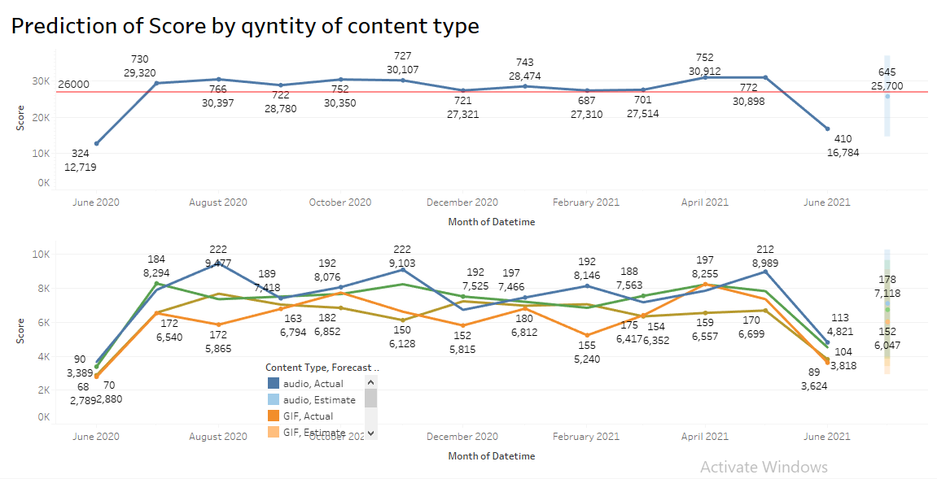
Notes:
Till now, we analyzed top 5 categories performance and concluded that the quantity of contents are directly proportional to the positive score.
However, the average score of top 5 categories per month is 26000 points. June 2021 has the score 16700 from 410 posts which is very low.
If we want to cross average reaction score that is 26,000 is by uploading more than 650 content types of top categories.
“This charts shows us that if we upload more than 180 audios, 175+ photos and 155+ videos and GIFs of top categories then the scores of top 5 categories can jump up to 26k to 27k of scores”.

Slide 14


ANALYSIS
Animals and science are the two most popular categories of content, showing that people enjoy "real-life" and "factual" content the most.
INSIGHT
Food is a common theme with the top 5 categories with "Healthy Eating" ranking the highest. This may give an indication to the audience within your user base. You could use this insight to create a campaign and work with healthy eating brands to boost user engagement.
Summary
And people are interested in photo and audios of top categories
NEXT STEPS
This ad-hoc analysis is insightful, but it's time to take this analysis into large scale production for real-time understanding of your business. We can show you how to do this.
Notes:
So to summarize:
We tackled this task and found the top 5 most popular categories as asked, but we also went one step further.
- We found that animal and science are the two most popular categories, suggesting that users like "real-life" and “factual” content
- We also found that food was a common theme amongst popular content and the most popular food category was healthy eating. This could be a signal to show the types of people that are using your platform, and you could use this insight to boost engagement even further. For example, you could run a campaign with content focused on this category or work with healthy eating brands to promote content.
- As much as this analysis was insightful, we are ready to take it to the next stage and we have the expertise within Accenture to help you realize these kinds of insights in production across your organization and in real time. We would love to help you with this.

Slide 15
Thank you!
ANY QUESTIONS?
Notes:
Thank you very much for listening, please feel free to ask any questions that you may have!

